Slide 1
Problem Statements & Assignment Planing
DO HOANG HUONG LIEN
NGUYEN HUU LIEM

Slide 2
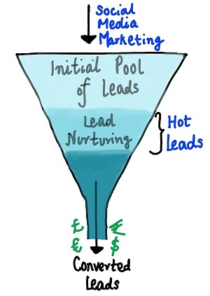
Stakeholders: An education company named X Education. Business Requirements: Identify the most potential leads, also known as ‘Hot Leads’. Data Analyst Requirements: Able to identify the leads that are most likely to convert into paying customers, with a target lead conversion rate to be around 80%. Model Requirements: A logistic regression model to assign a lead score between 0 and 100 to each of the leads which can be used by the company to target potential leads.
Problem Statement

Slide 3
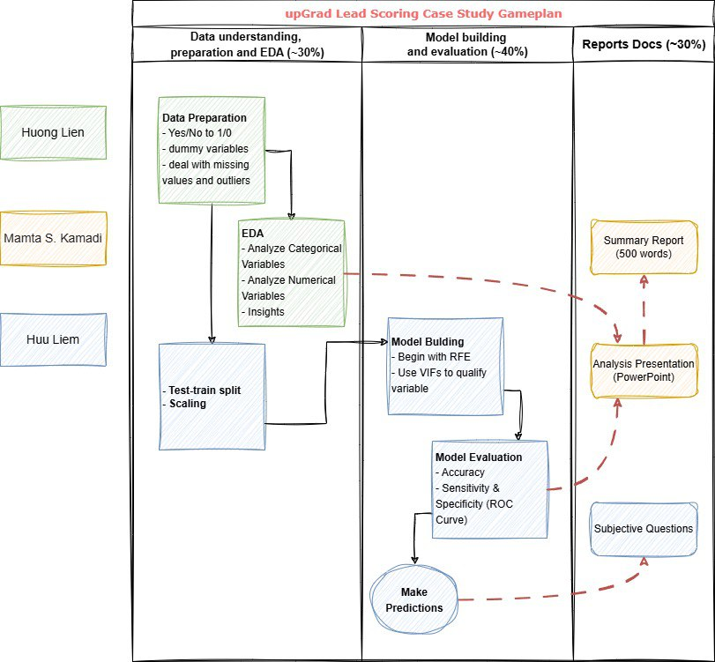
Assignment Planing
Actual Contributions: Huong Lien:
As planed, plus the Presentation Huu Liem:
As planed, plus the Presentation & Summary Report Mamta S. Kamadi
Absolutely NONE.
All her works has been detected as plagiarism.

Slide 4
Data Preparation and EDA
DO HOANG HUONG LIEN
NGUYEN HUU LIEM

Slide 5
- Rename some columns to a shorter and more straightforward name. E.x: “What is your current occupation” to “occupation” - Drop cols with just a single variable - Clean categorical variables using RegEx, deal with low quality variable (E.x some columns contain “Select”) - Impute missing value in numerical variables - Variable conversion (Yes/No to 1/0) - Identify and remove Outliers from “TotalVisits” and “Page Views Per Visit” using percentiles. Removing outliers will provide a better Scaler later on.
Data Preparation

Slide 6
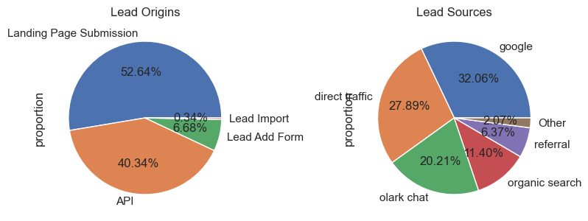
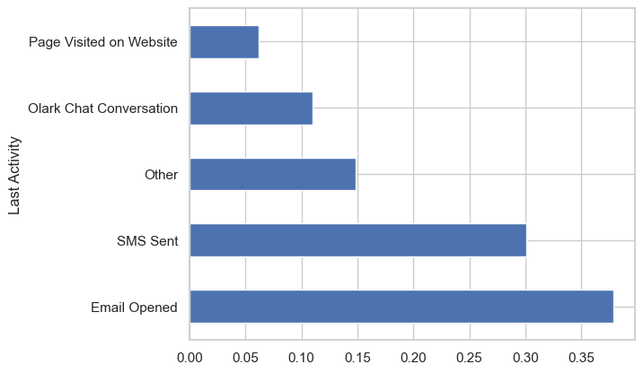
- The origin of leads mainly is from "Landing Page Submission" and "API" - The source of leads mainly is from "google" and "direct traffic"
EDA
- Most of the customers are okay with receiving emails and calls about the course with over 90% say "No" with "Do not email" or "Do not call" even nearly 100%.
- However, almost advertisement platforms or measurements are not really effective, because almost 100% customers said "No" about seeing ad before. Only in "free_copy_mastering_interview" field, there is 31,8% customers having desire to receive a free copy of 'Mastering the Interview'.
- Only 1/6 Leads are marked as Potential
- Before the leads get converted, users were open their Email or sent SMS.

Slide 7
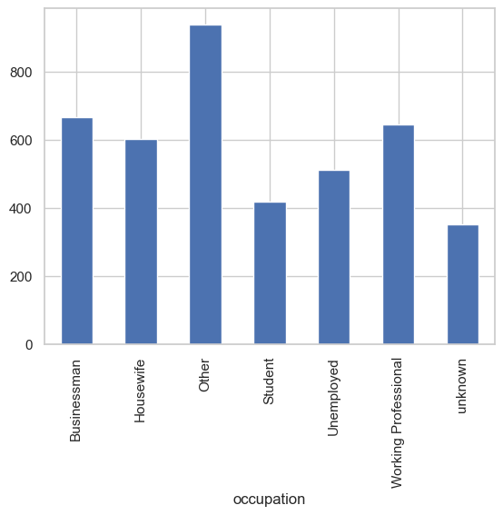
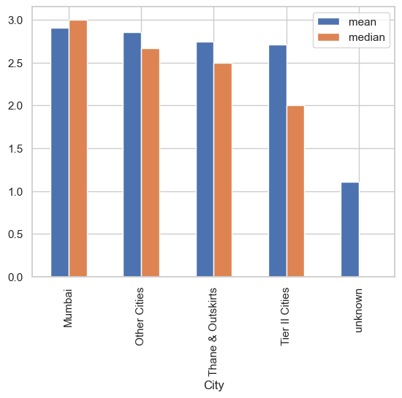
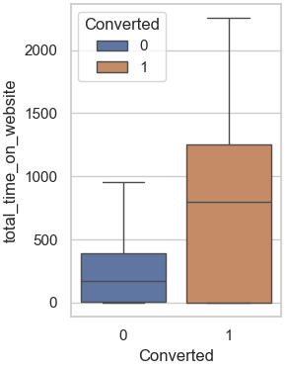
EDA
- People who spent the most time on website are Businessman or working Professional
- Mumbai, Thane & Outskirts, and other cities have equal mean and median values, indicating symmetric data distributions.
- Tier II Cities has a higher mean than median, suggesting a right-skewed distribution.
- Converted Leads have doubled total time on website compared to non-converted leads

Slide 8
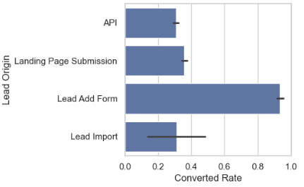
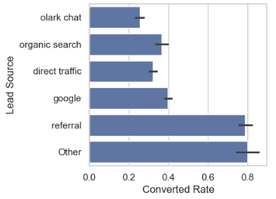
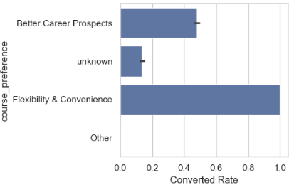
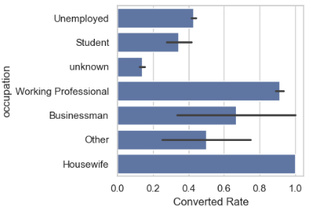
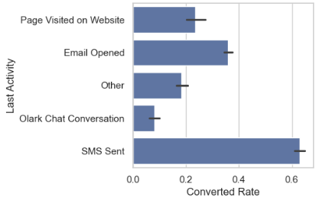
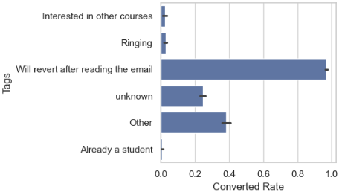
EDA
- Some strong indicators of a promising lead:
+ Lead Origin: Lead Ad Form. This form initiate good leads
+ Lead Source: referral. Referral Source brings quality leads
+ Last Activity: SMS Sent. This will be a good signal
+ Occupation: Housewife, Professional
+ Course Prefers: Flexibility & Convenience. Seems like the company is delivering this aspect.
+ Tags: Will revert after reading the email. They definitely will!

Slide 9
Model building & Evaluation
DO HOANG HUONG LIEN
NGUYEN HUU LIEM

Slide 10
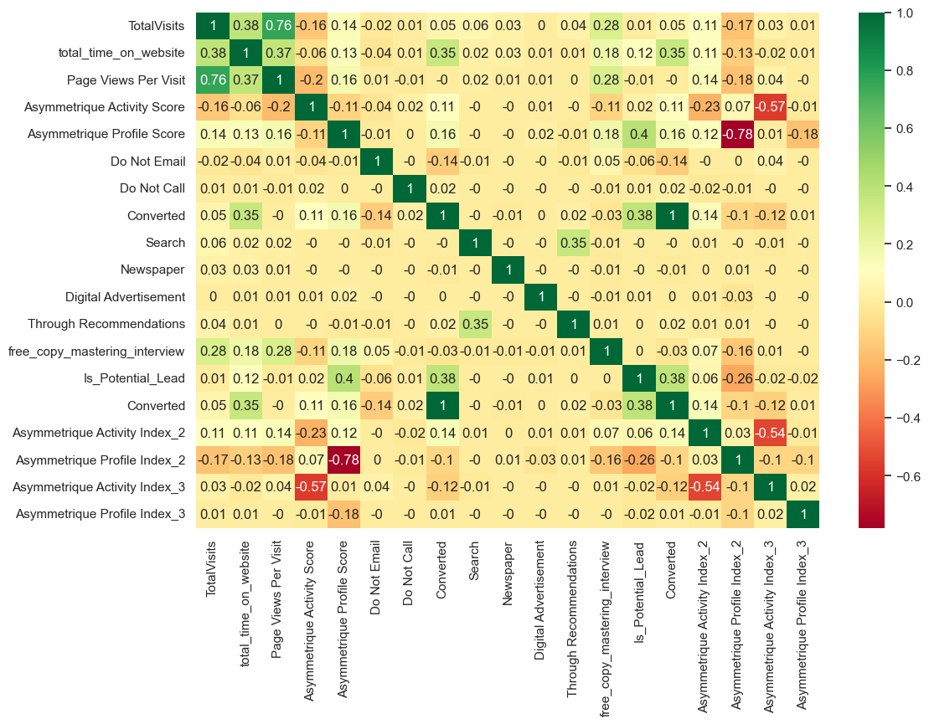
Some key observations:
- ‘TotalVisits’ and ‘total_time_on_website’ have a strong positive correlation (0.38).
- ‘Page Views Per Visit’ shows a strong correlation with ‘TotalVisits’ (0.76). - The ‘Profile Index’ and ‘Activity Index’ dummy variables have high correlation with the ‘Asymmetrique Score’ dummy variables. We should drop those dummy columns to avoid collinearity.
Test-train split and scaling

Slide 11
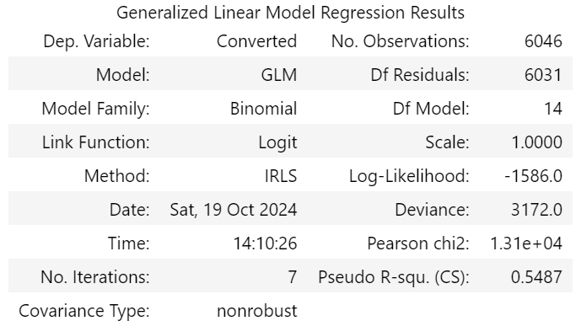
Pseudo R-squared (CS) of 0.5487 - This is a measure of how well the model fits the data. In logistic regression, Pseudo R-squared values can vary between 0 and 1, with higher values indicating better fit. - A value of 0.5487 suggests a reasonably good fit, meaning the model explains about 54.87% of the variance in the dependent variable ‘Converted’
Model building

Slide 12
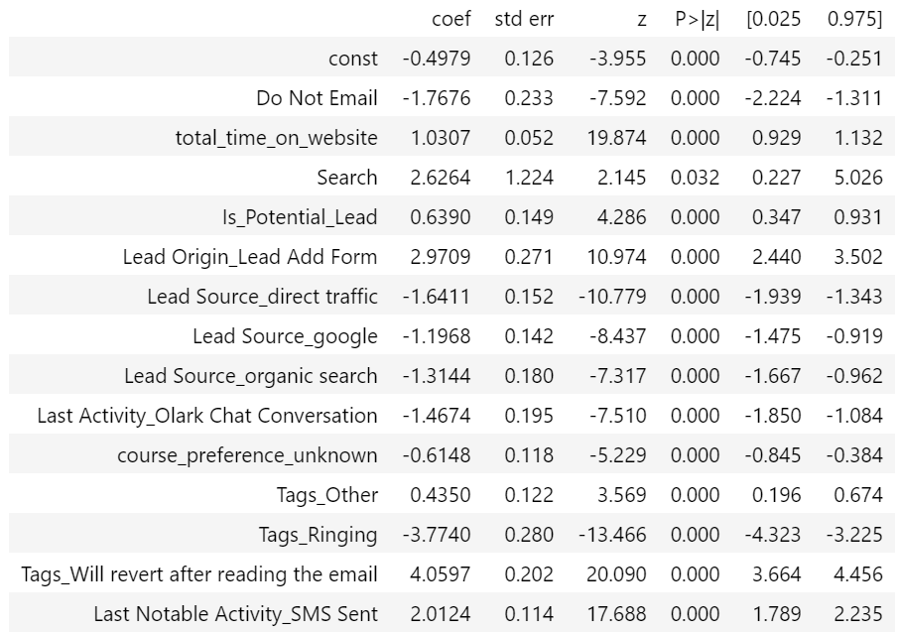
Significance of Variables Almost all the variables have p-values close to 0, which indicates that they are statistically significant in predicting the probability of conversion. The most significant features include:
Model building
Do Not Email
total_time_on_website
Lead Origin_Lead Add Form
Tags_Will revert after reading the email
Last Notable Activity_SMS Sent

Slide 13
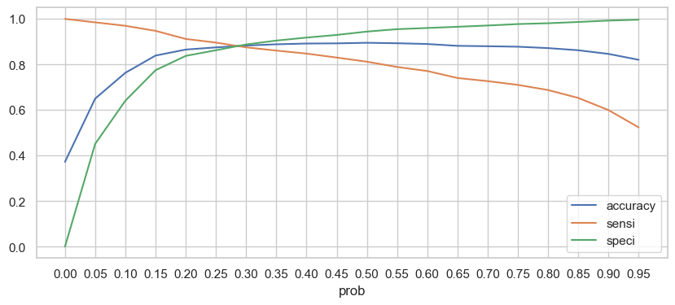
The the variation in model performance metrics—accuracy, sensitivity (sensi), and specificity (speci)—across different probability thresholds.
Model evaluation
- For the best performance in both statistics side and business side, we pick the Cutoff point of 0.28, to achieve Accuracy & Sensitivity & Specificity of 0.88. This will allow lead conversion rate to be around 80%.

Slide 14
Accuracy: The blue line represents the overall accuracy of the model, showing how well the model predicts conversions at different probability thresholds. It peaks around the 0.3 threshold.
Sensitivity (Sensi): The orange line indicates sensitivity, or the true positive rate. It's highest at lower thresholds, meaning the model is better at identifying actual conversions when it allows more predictions to be positive.
Specificity (Speci): The green line shows specificity, or the true negative rate. It's highest at higher probability thresholds, indicating that the model is better at correctly identifying non-conversions when it requires stronger evidence to predict conversion.
Optimal Threshold: The intersection points and relative heights can help determine an optimal threshold where the model maintains a balance between sensitivity and specificity, often aligned with high accuracy.

Slide 15
So we end up with a model with 0.88 accuracy & sensitivity & specificity on the train test, and 0.87 accuracy & sensitivity on the test set.
A drop of only 0.01 indicate a reliable model had been build!
Evaluation test-set
Confusion Matrix
 | Predicted Not Converted (0) | Predicted Converted (1)
Actual Not Converted (0) | 1388 | 204
Actual Converted (1) | 128 | 872

Slide 16
Thank You!

